Slide 1
ASP.NET Core

Slide 2
Using the Entity Framework

Slide 3
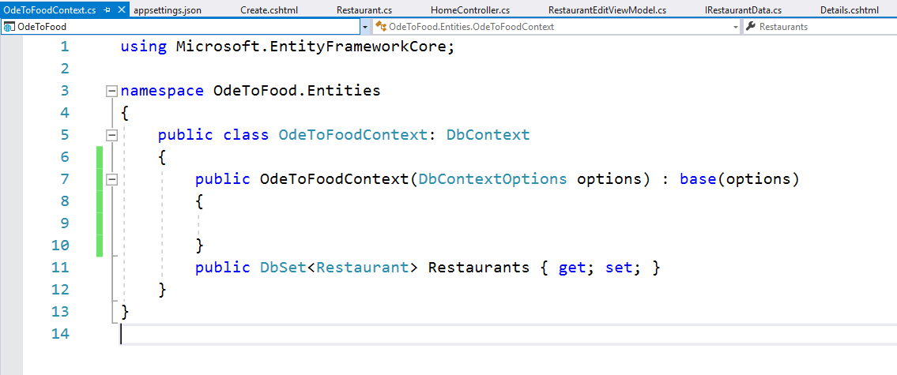
Entity Framework Core
Install Entity Framwork Core (Microsoft.EntityFrameworkCore.SqlServer)
Create the Context Class

Slide 4
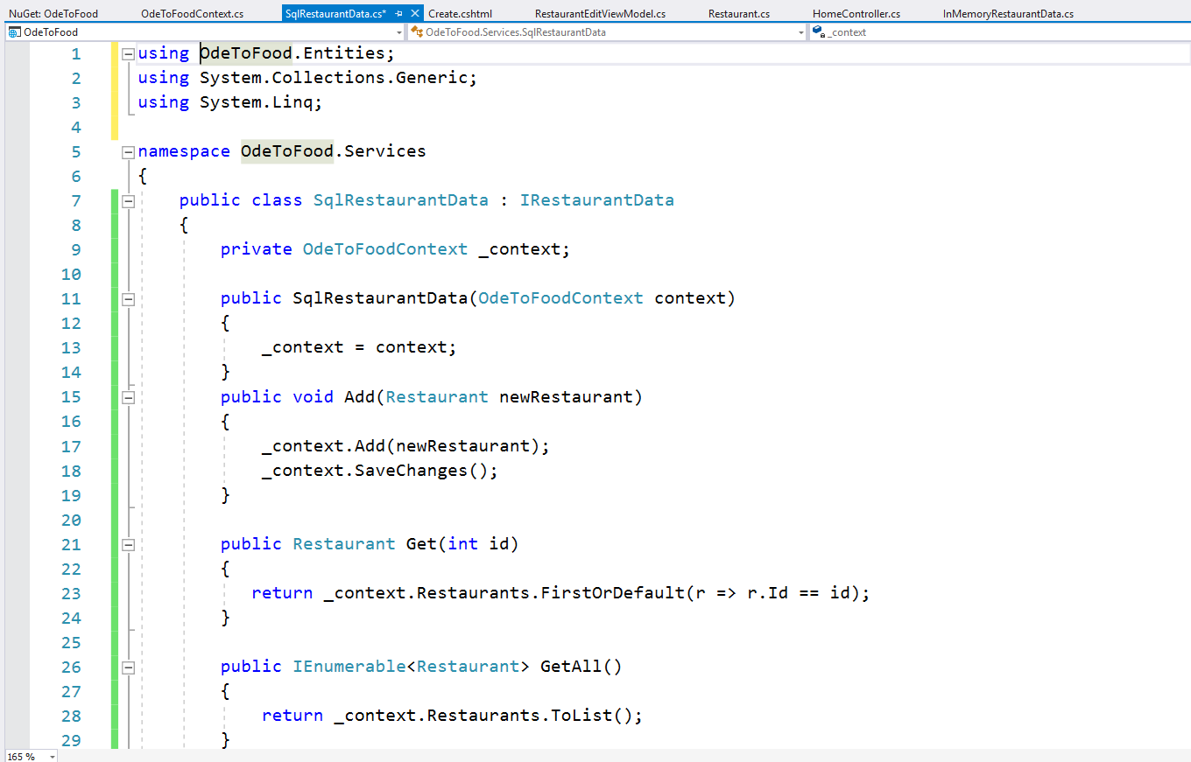
Entity Framework Core
Add the SqlRestaurantData Class

Slide 5
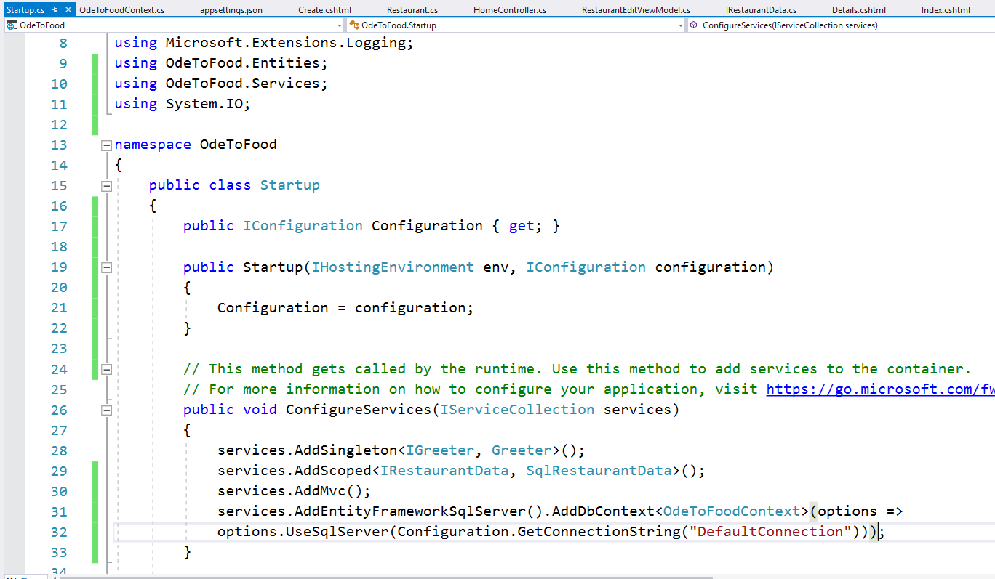
Entity Framework Core
Add EntityFramework

Slide 6
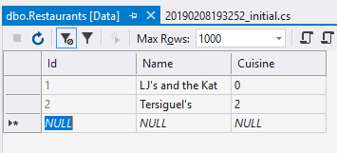
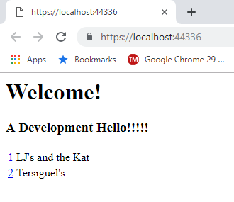
Entity Framework Core
Add-Migration initial
Update-database
Add some data in the Restaurant table
Create a new restaurant in the form by navigating to /home/create

